Slide 1

SMART LAND OWNERSHIP VERIFICATION AND ENCUMBRANCE PORTAL
24CSC52 – AGILE METHODOLOGIES
NISHA SHREE B – TEAM LEAD/TESTER
MONIKA B – DEVLOPER
MOONIKA SRI R – DEVELOPER
NATCHATHRA R - DEVELOPER

Slide 2
PROJECT STATEMENT
OBJECTIVES
TerraVerify AI is a smart portal for land ownership and document verification using OCR and machine learning to identify potential fraud.
Simplify land record search and verification.
Extract document details using OCR.
Verify ownership information.
Detect suspicious documents using Random Forest.
Provide a fraud risk score.
Reduce manual effort and errors.

Slide 3
PRODUCT BACKLOG
ID | User Story | Priority | SP
US-01 | Registration & Login | High | 5
US-02 | User Dashboard | High | 5
US-03 | Land Search | High | 5
US-04 | Property Details | High | 3
US-05 | Document Upload | High | 5
US-06 | OCR Verification | High | 5
US-07 | Ownership Verification | High | 5
US-08 | Dataset & Data Preprocessing | Medium | 3
US-09 | Fraud Risk Detection | High | 5
US-10 | Verification Result & Risk Score | High | 5

Slide 4
TerraVerify AI – Agile Sprint Planning
Development Methodology: Agile methodology is followed to develop the TerraVerify AI system in small, manageable increments.
Project Duration: The complete project is planned for 3 months.
Sprint Structure: The project is divided into 6 development sprints.
Sprint Duration: Each sprint is planned for approximately 2 weeks.
Sprint Planning: At the beginning of every sprint, user stories are selected and tasks are assigned to the respective team members.
Incremental Development: Each sprint focuses on implementing and completing a specific set of project features.
Team Collaboration: Frontend, backend, OCR, ML, and testing activities are coordinated throughout the sprints.
Testing: Developed features are tested continuously during each sprint to identify and fix errors early.
Sprint Review: Completed features are reviewed at the end of every sprint.
Feedback & Improvement: Feedback from reviews is used to improve features and plan the next sprint.
Final Outcome: All completed increments are integrated to deliver the fully functional TerraVerify AI portal.

Slide 5
MONIKA – FRONTEND DEVELOPER
Scrum Tasks: SCRUM-18, SCRUM-16
Responsibilities: Develop React UI, Dashboard, Land Search, Property Details, Ownership Verification and frontend-backend integration.
Deliverables: Functional frontend with Dashboard, Land Search, Property Details, Ownership Verification and API integration.

Slide 6
MOONIKA SRI R – BACKEND DEVELOPER
Scrum Tasks: SCRUM-11, SCRUM-16
Responsibilities: Develop Registration, Login, Authentication, User Management, REST APIs, Database integration and frontend-backend connectivity.
Deliverables: Working backend server with Authentication, User Management, REST APIs and Database integration.

Slide 7
NATCHATHRA R – OCR & DATASET DEVELOPER
Scrum Tasks: SCRUM-13, SCRUM-14
Responsibilities: Develop Document Upload, PDF/Image Processing, TerraSet OCR, data extraction, dataset preparation, preprocessing and feature selection.
Deliverables: Document Upload and TerraSet OCR module with structured data extraction and prepared ML dataset.

Slide 8
NISHA SHREE B – ML, TESTING & DOCUMENTATION
Scrum Tasks: SCRUM-10, SCRUM-15, SCRUM-17
Responsibilities: Develop Random Forest fraud detection, prediction API, ML evaluation, system testing, bug fixing, SRS and final documentation.
Deliverables: Trained Random Forest model, Fraud Risk API, ML evaluation metrics, tested system and project documentation.

Slide 9
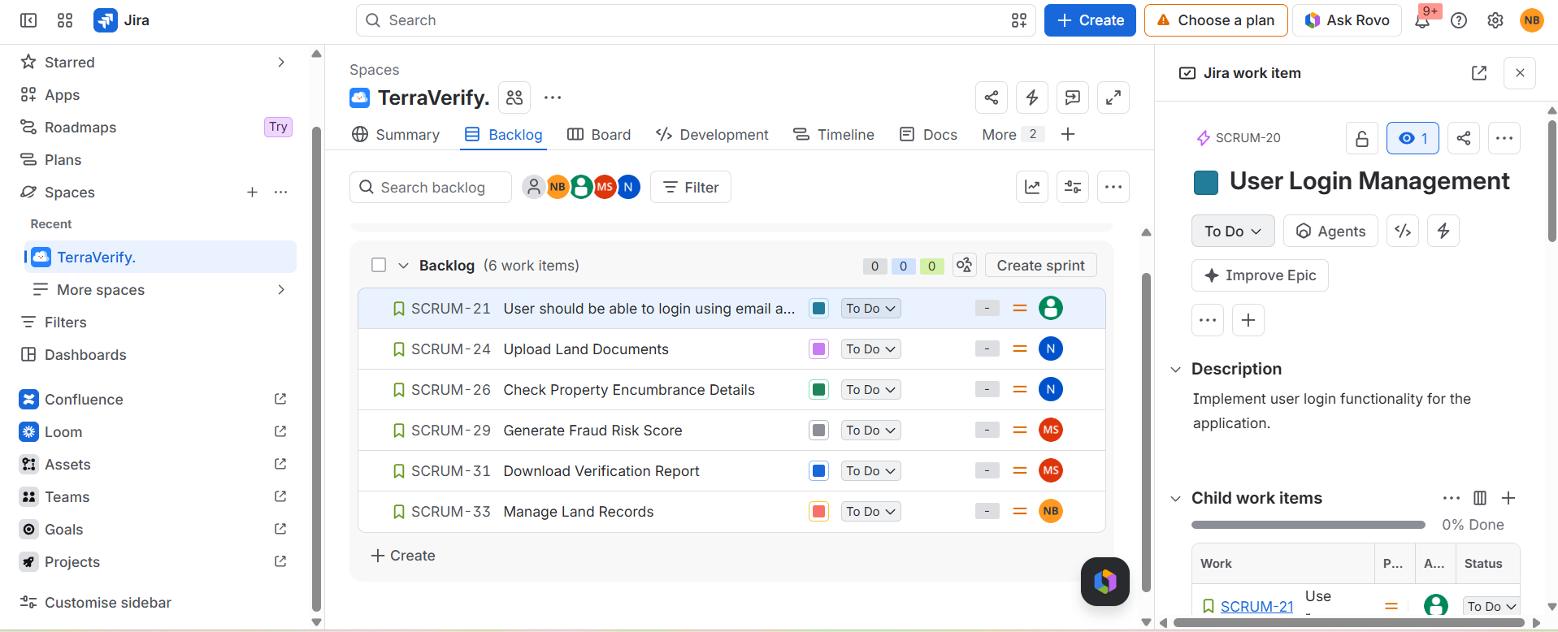
SPRINT 1

Slide 10
